Slide 1
Group work - Day 5
CRISPR genome engineering for cellular modelling and screening 2024
Matt Coelho and Kalpana Surendranath

Slide 2
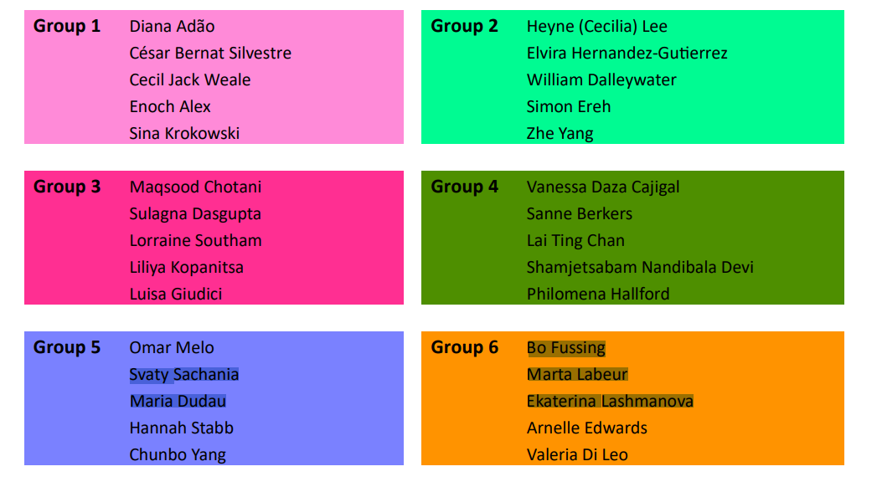
Project groups

Slide 3
Objective
Revisiting and consolidating your learning from days 1 to 4, the group work will provide an opportunity to design your study, from selecting the model to collecting and analysing data.

Slide 4

Methods, Strategies, and Justification
There are no “correct” answers here. Just justify your approach.
Single nucleotide variant in the promoter
Which CRISPR technology might you use?
How will you design your gRNAs?
Which cell type?
How might you validate the engineered cell model?
1. model
What gRNA library might you use?
Which controls will be important to include
What will your screen readout be and how will you measure this?
2. screen
What normalizations would be relevant for the sequencing data?
Which statistical approach might you use to analyse the screen?
Describe any validation or next steps
3. analysis
Matt Coelho

Slide 5
Structuring your work
This is a 10-minute group presentation with 5 minutes allocated for questions.
You may emphasize one or more categories (Model, Screen, and Analysis) in your discussion.
The presentation can be delivered by all team members or by a selected representative

Slide 6
Scenario
A mutation in the promoter of the gene B2M has recently been found to alter the expression of B2M, a cell surface protein. This leads to an uncommon blood disorder.
The presence of the mutation does not always lead to disease, suggesting there are other factors at play. Your research team has been tasked with identifying genes involved in disease progression - particularly new drug targets to reverse the blood disorder.
Describe a CRISPR-based workflow to introduce the promoter mutation in B2M in a cell model.
Describe how you would design a CRISPR KO screen to identify modulators of B2M expression in this modified cell model.
For each step, give a rationale for your approach and describe the analysis in each case.

